Slide 1
Gulf of Guinea Northern Regions Social Cohesion (SOCO) Project
SELECTION AND ROLE OF COMMUNITY FACILITATORS AND COMMUNITY PROJECT IMPLEMENTATION COMMITTEES

Slide 2
SUBPROJECT IMPLEMENTATION STRUCTURES
Cluster of communities to implement subprojects, with each MMDA creating between three (3) to four (4) clusters ---this is confusing----delete
Total of eight (8) to twelve (12) neighbouring communities per cluster – comment (this was revised in the PIM—refer and review)
Community Project Implementation Committees (CPICs) to be formed from inception in each cluster of communities to facilitate all aspects of project implementation

Slide 3
SUBPROJECT IMPLEMENTATION STRUCTURES

Slide 4
COMPOSITION OF CPICs
The MMDA, with the facilitation of the CFs, through consultations, will assist the DAs in the formation of the CPICs per the steps below;
Each community in the cluster will select two (2) community representatives (at least one female and one of whom will be a youth, i.e., aged from 18-35 years old).
Select additional representatives (not exceeding four persons) from vulnerable groups (e.g. pastoralists, persons with disability, etc.) within the Cluster who may not be already represented.
CFs will serve as ex-officio members of the CPIC without voting rights.
The Chairman and Secretary of the beneficiary UZTACs and Assembly Member(s) within the cluster will be invited to participate in CPIC meetings as advisors.

Slide 5
SELECTION OF COMMUNITY REPRESENTATIVES TO CPIC
The two community representatives to the CPIC will be selected using the steps below;
Each community will hold a meeting to explain the roles of CPIC members to the entire community.
State and explain the criteria for selecting the two (2) representatives:
  - have demonstrated ability to mobilise the community and vulnerable groups.
- have integrity, be honest and trustworthy.
- not be partisan and does not hold any political position.
- be able to commit time to participate in the meetings and trainings.
- be prepared to serve as a volunteer since there will be no remuneration except transportation allowance for stipulated official assignments, including meetings.
Once selected, the names of the two (2) representatives will be submitted to the MMDA for validation.

Slide 6
TENURE OF THE CPICs
The CPICs will have the mandate below;
The CPIC at its first meeting will elect a Chairperson, Secretary and Organiser (at least one of whom should be a female) upon formation.
The CPIC will meet quarterly to discuss project implementation-related issues. Other meetings may be held, as approved by the DA and ZCO.
CPIC shall meet a maximum of six (6) times in a year.
The CPIC membership shall serve a term of 2 years with the possibility of being re-elected to serve for another term.

Slide 7
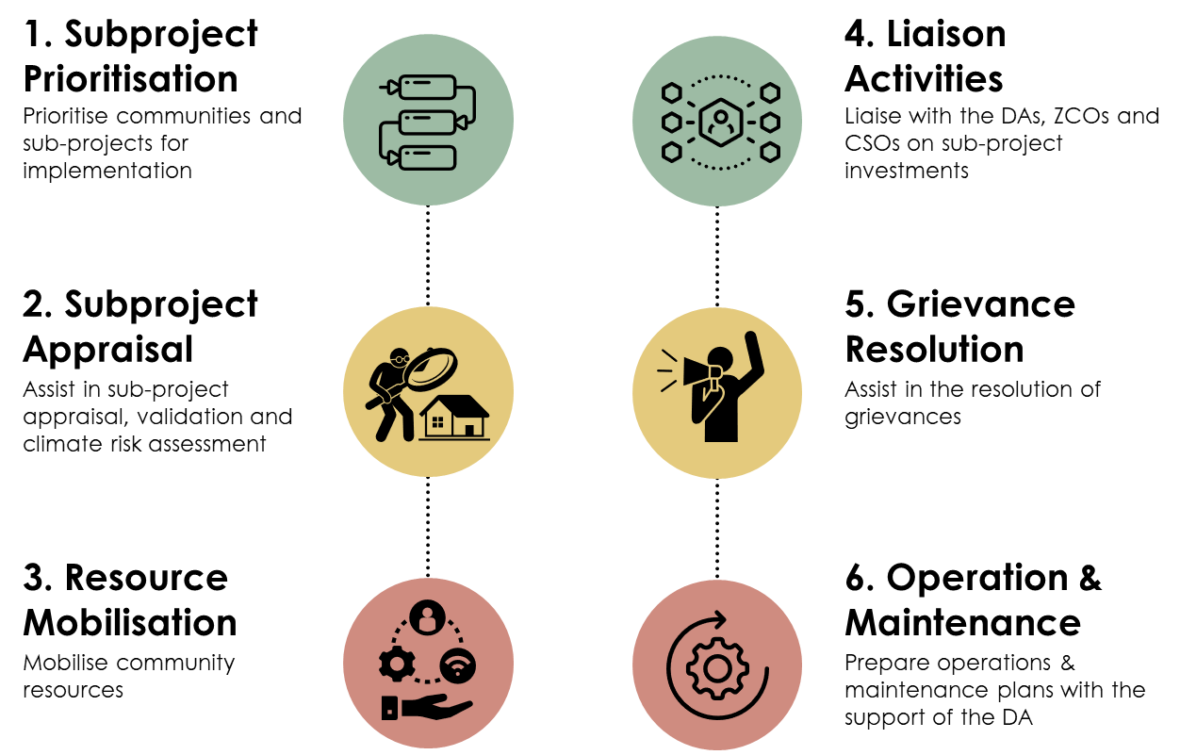
ROLE OF CPICs

Slide 8




WHO ARE THE COMMUNITY FACILITATORS?
Two (2) CFs are recruited per cluster; one (1) for infrastructure subproject and the other for LED and social cohesion activities
Will be equipped with motorbikes to ease their movements to communities within the clusters
Clusters are a collection of neighbouring communities
Will be provided with tablets to help with data collection activities

Slide 9
CRITERIA FOR SELECTION OF CFs
1. Must be between 25 and 55 years.
2. Must have at least secondary school education.
3. Have community mobilisation skills and willingness to serve the community.
4. Have knowledge and awareness of the various groups that exist in the cluster and the local dynamics/social context.
5. Must reside within/near the cluster of communities.
6. Proficient in the use of digital tools.
7. Have experience with managing or participating in community development.

Slide 10
CRITERIA FOR SELECTION OF CFs
8. Have integrity, be honest and trustworthy.
9. Must not be involved in any conflict, community-level disputes, violence, and criminal activity.
10. Must not be partisan and do not hold a political position.
11. Can speak the local languages in the cluster.
12. Proficiency in data collection and reporting would be an advantage.

Slide 11
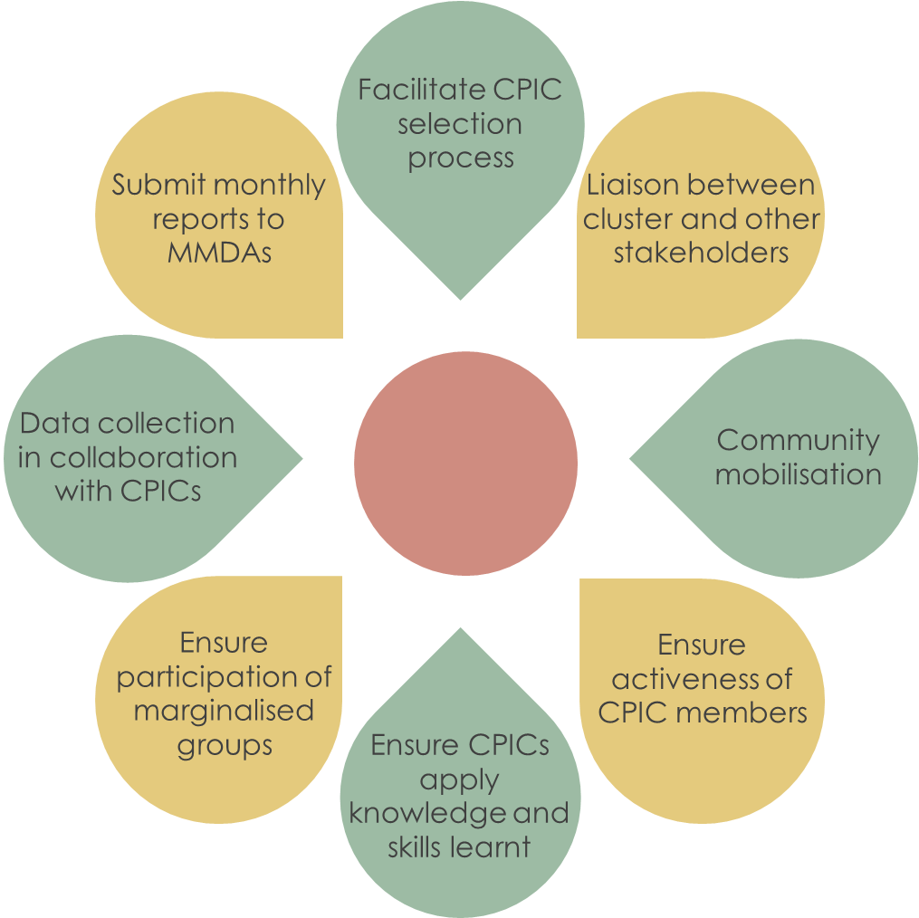
ROLES AND RESPONSIBILITIES OF CFs
The Community Facilitators will perform these general roles and responsibilities:

Slide 12
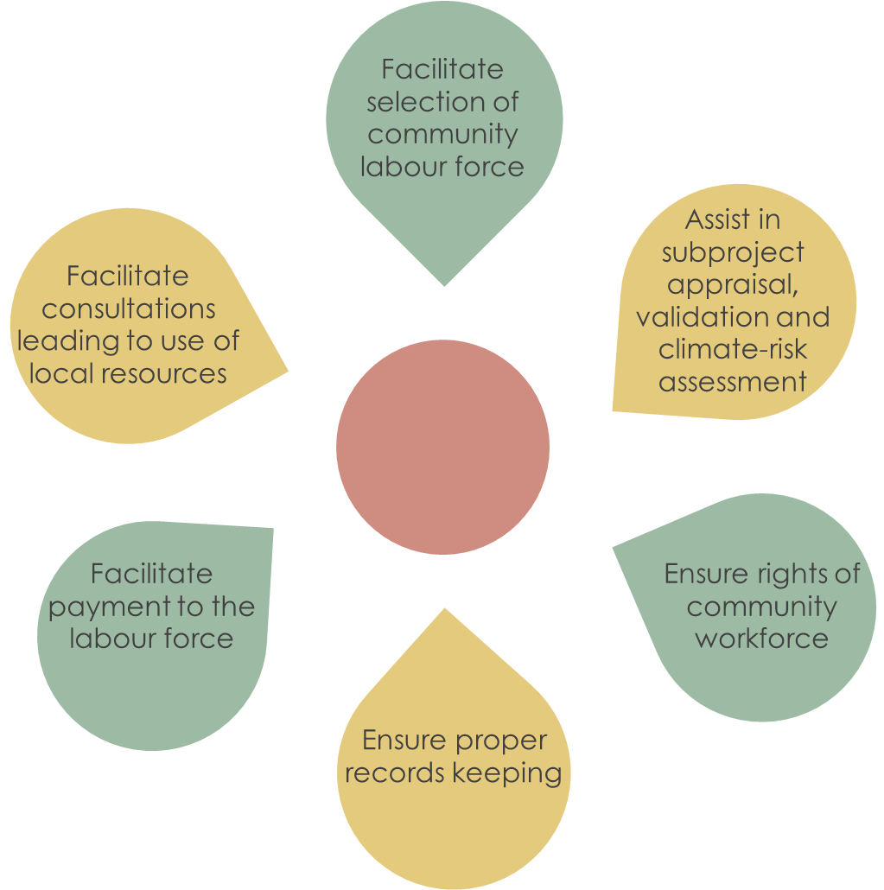
ROLES AND RESPONSIBILITIES OF CFs
In addition to the general roles and responsibilities, the CFs focusing on infrastructure will be responsible for the following:

Slide 13
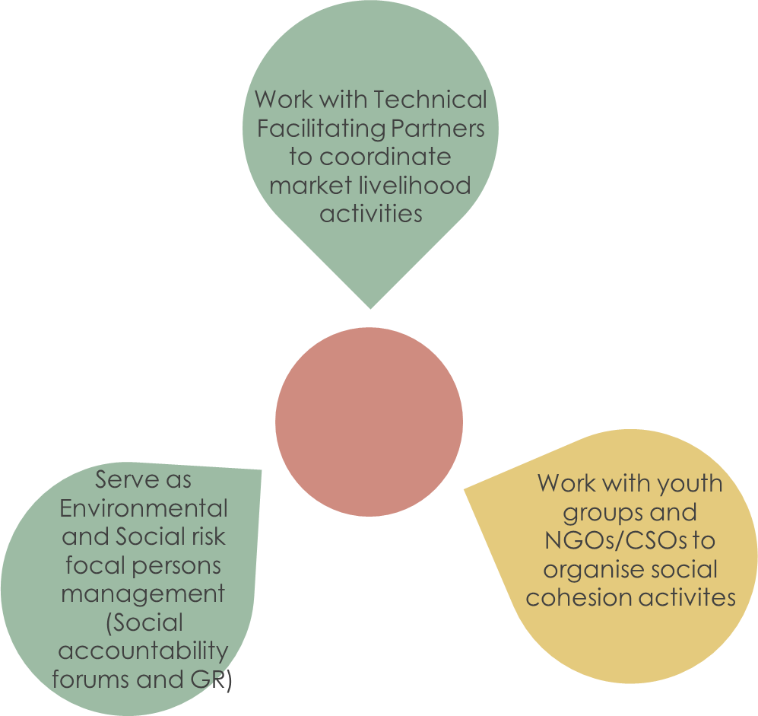
ROLES AND RESPONSIBILITIES OF CFs
The Community Facilitators focusing on non-infrastructure investments will have these additional
responsibilities:

Slide 14
THANK YOU

