Slide 1
Gulf of Guinea Northern Regions Social Cohesion (SOCO) Project
DIGITAL INNOVATIONS DEEP DIVE SESSION – MAY 4, 2023
PRESENTATION ON AREAS OF POTENTIAL COLLABORATION

Slide 2
OVERVIEW OF DIGITAL INNOVATIONS UNDER THE SOCO PROJECT
1
SOCO MIS & SOCO CDD App
2
GRM (Unified Case Management System under SWCES)
3
Knowledge Management Platform
4
Support the piloting of innovative digital solutions to advance communities' socio-economic and climate resilience as well as promote social entrepreneurs and enterprises

Slide 3
KEY AREAS OF FOCUS FOR YEAR ONE
Create community digital ambassadors out of Community Facilitators (CFs)
1
To empower thousands of community leaders, including women and youth
Community Digital Ambassadors
2
3
To lead their communities into an inclusive digital economy

Slide 4
KEY AREAS OF FOCUS FOR YEAR ONE (CONT.)
1
Partnership with UBIDS
Engage and train about 500 students to collect a comprehensive set of data from beneficiary clusters/communities from all 48 districts every year
Digital Data Fellows
2
3
Usage of SOCO MIS and SOCO CDD Application for data collection

Slide 5
KEY AREAS OF FOCUS FOR YEAR ONE (CONT.)
Trained beneficiary youth, especially girls, women and persons with disabilities (PwDs)
1
Digital skills for job acquisition and entrepreneurship enhancement
2
In both soft and hard digital literacy skills
3
Create employability skills and/or enhance entrepreneurship

Slide 6
PROPOSED PARTNERSHIPS
1
Solutions for Youth Employment (S4YE)/Microsoft
Two Partnerships Proposed
2
GIZ (Digital Transformation for Sustainable Development)

Slide 7
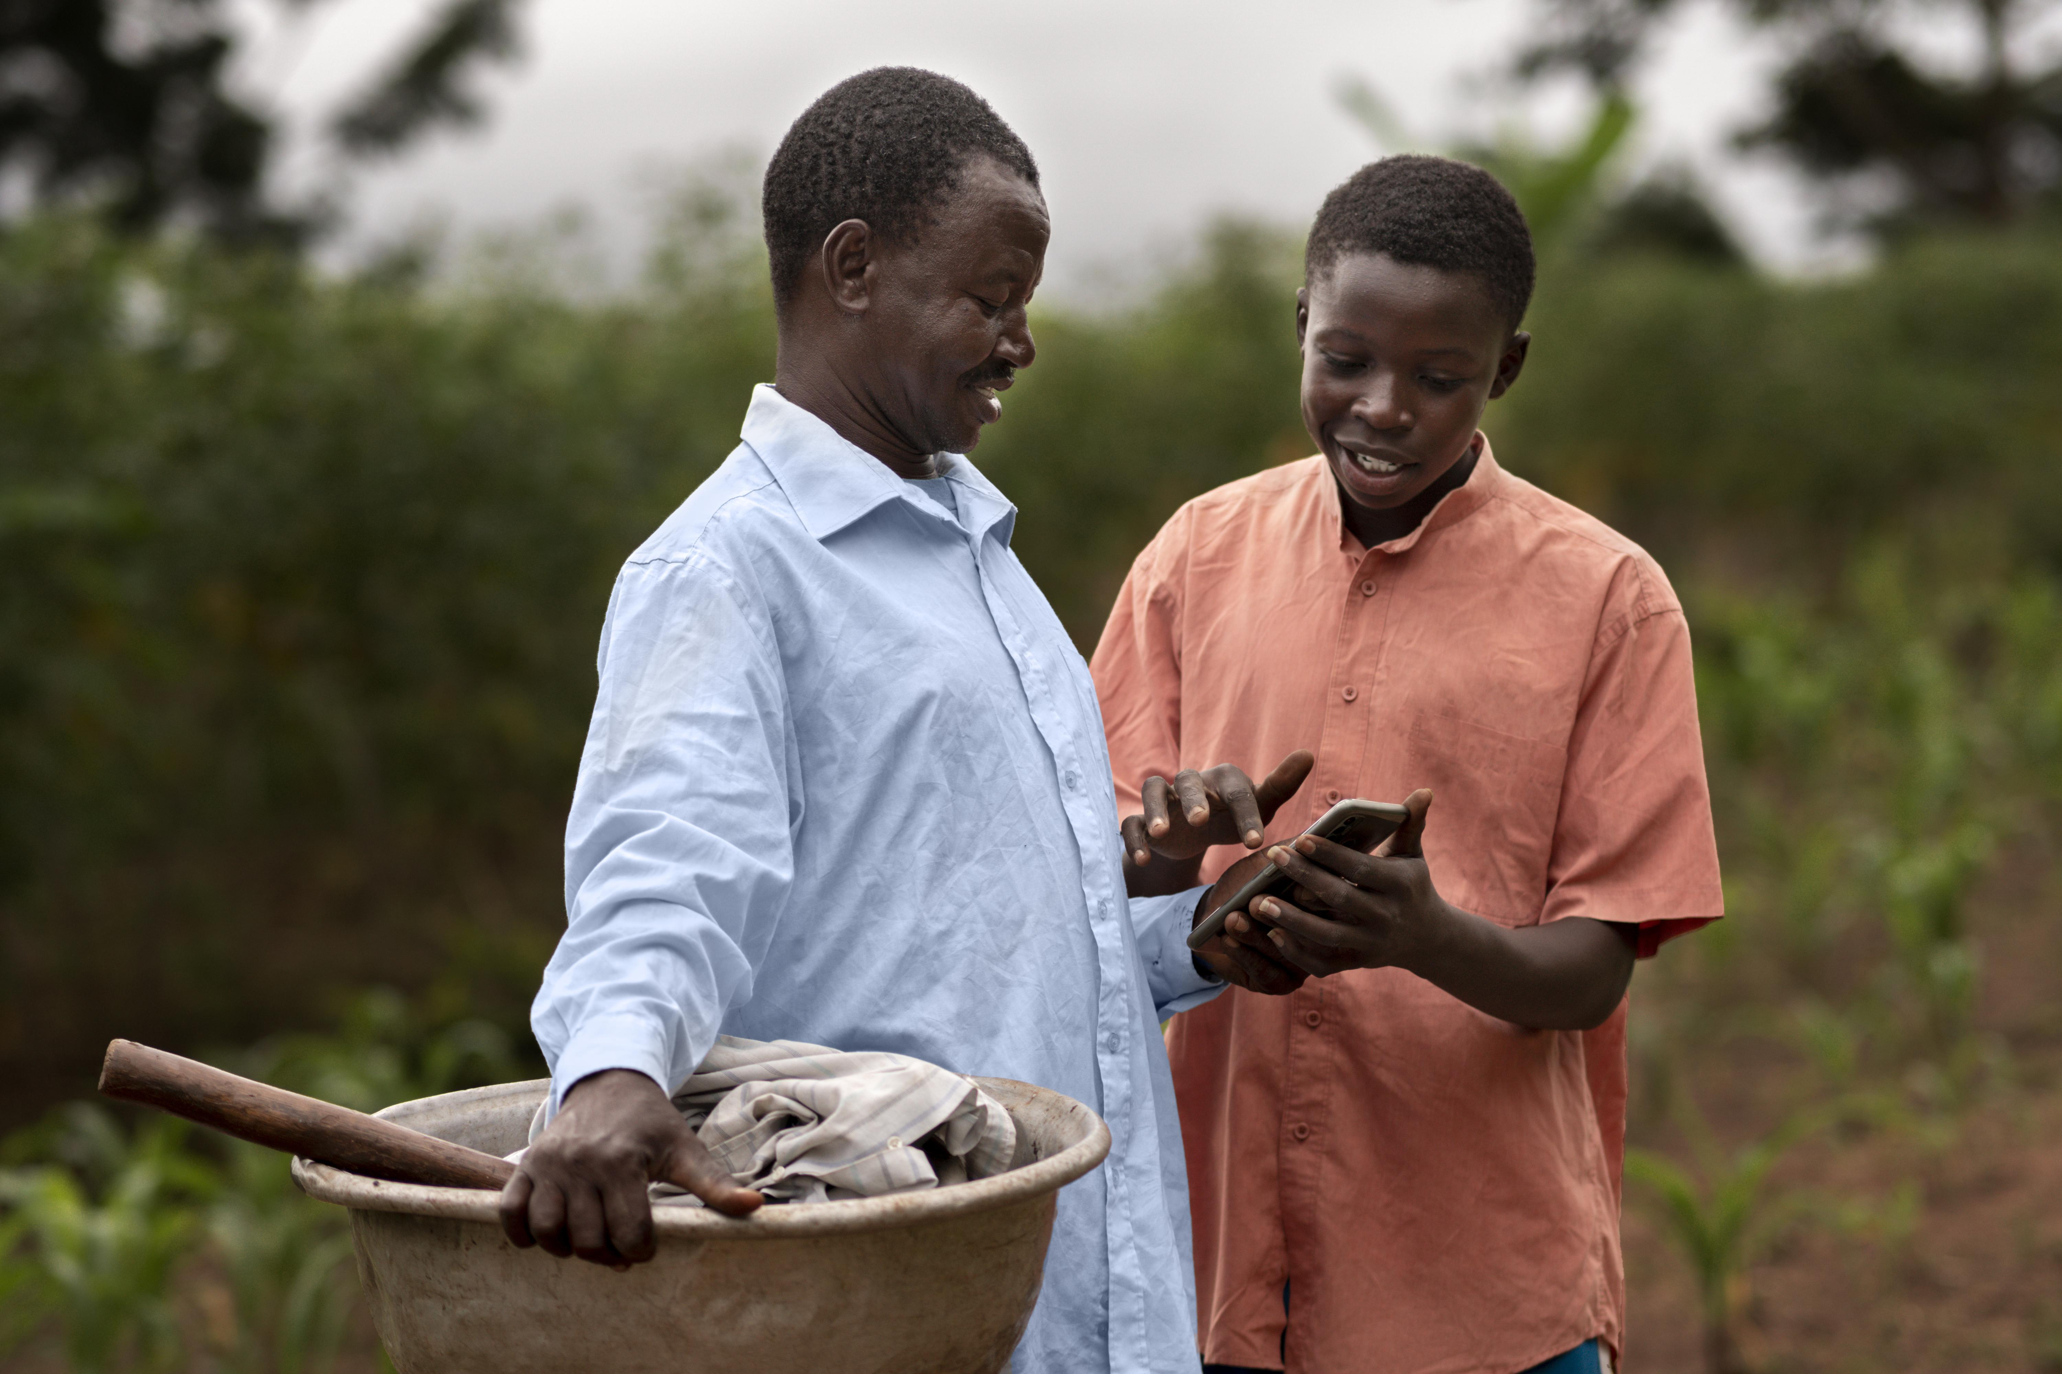
IMMEDIATE IMPLEMENTATION FOCUS (NEXT 6 MONTHS)
Creation of Community Digital Ambassadors out of Community Facilitators (CFs)

Slide 8
ABOUT COMMUNITY FACILITATORS (CFS)
1
2
DAs are required to recruit two (2) CFs per Cluster
Infrastructure delivery investments
LED and Social Cohesion Activities
3
4
Clusters are a collection of communities
Serve as liaisons between the community and DAs, service providers and other stakeholders
They will be equipped with motorbikes, tablets and apps to be used for their activities

Slide 9
CREATION OF DIGITAL AMBASSADORS OUT OF CFS
ENGAGE CFs
BUILD DIGITAL SKILLS OF CFs
The recruitment process for CFs has already begun, with about 200 of them engaged so far on the project
Through partnership with S4YE/Microsoft, tailor-made courses will be developed to train the CFs. GIZ’s local training partners will be leveraged on.
PROVIDE THEM WITH TABLETS
Preparations are far advanced to procure tablets with biometric features for the CFs to use for their activities
ORIENT CFs ON SOCO PROJECT
CFs will be oriented on the objectives of the SOCO Project, with more light expected to be thrown on the digital innovation requirements
DEPLOY CFs TO COMMUNITIES
ASSESSMENT OF CFs
Finally, CFs will be deployed to the field to serve as digital ambassadors in a bid to empower community leaders, especially youth and women, to promote digital inclusion
CFs will be assessed on their knowledge of digital technology. This will help accurately determine their training needs

Slide 10
WHERE PARTNERS COME IN
Leverage on Microsoft’s digital skills curricula to beneficiaries of World Bank operations
1
Build digital literacy skills of CFs through both partnerships with S4YE/Microsoft & GIZ
2
Leverage on DTEG’s local training partners

Slide 11
NEXT STEPS
PRESENTATION OF PARTNERS’ INITIATIVES
GENERAL DISCUSSIONS ON PROPOSED AREAS OF PARTNERSHIP
FOLLOW UP ENGAGEMENTS TO AFFIRM DECISIONS TAKEN
FINALISE AGREEMENT
Conclude terms of agreement between the SOCO Project and Partners. Finalize the terms of agreement to underpin the partnership
Partners’ presentation on their individual projects
Have a deeper discussion on Partners’ activities and proposed areas of collaboration
Have follow-up engagements between the three teams to firm up decisions taken during the deep dive session

Slide 12
THANK YOU

