Slide 1
Gulf of Guinea Northern Regions Social Cohesion (SOCO) Project
OVERVIEW

Slide 2
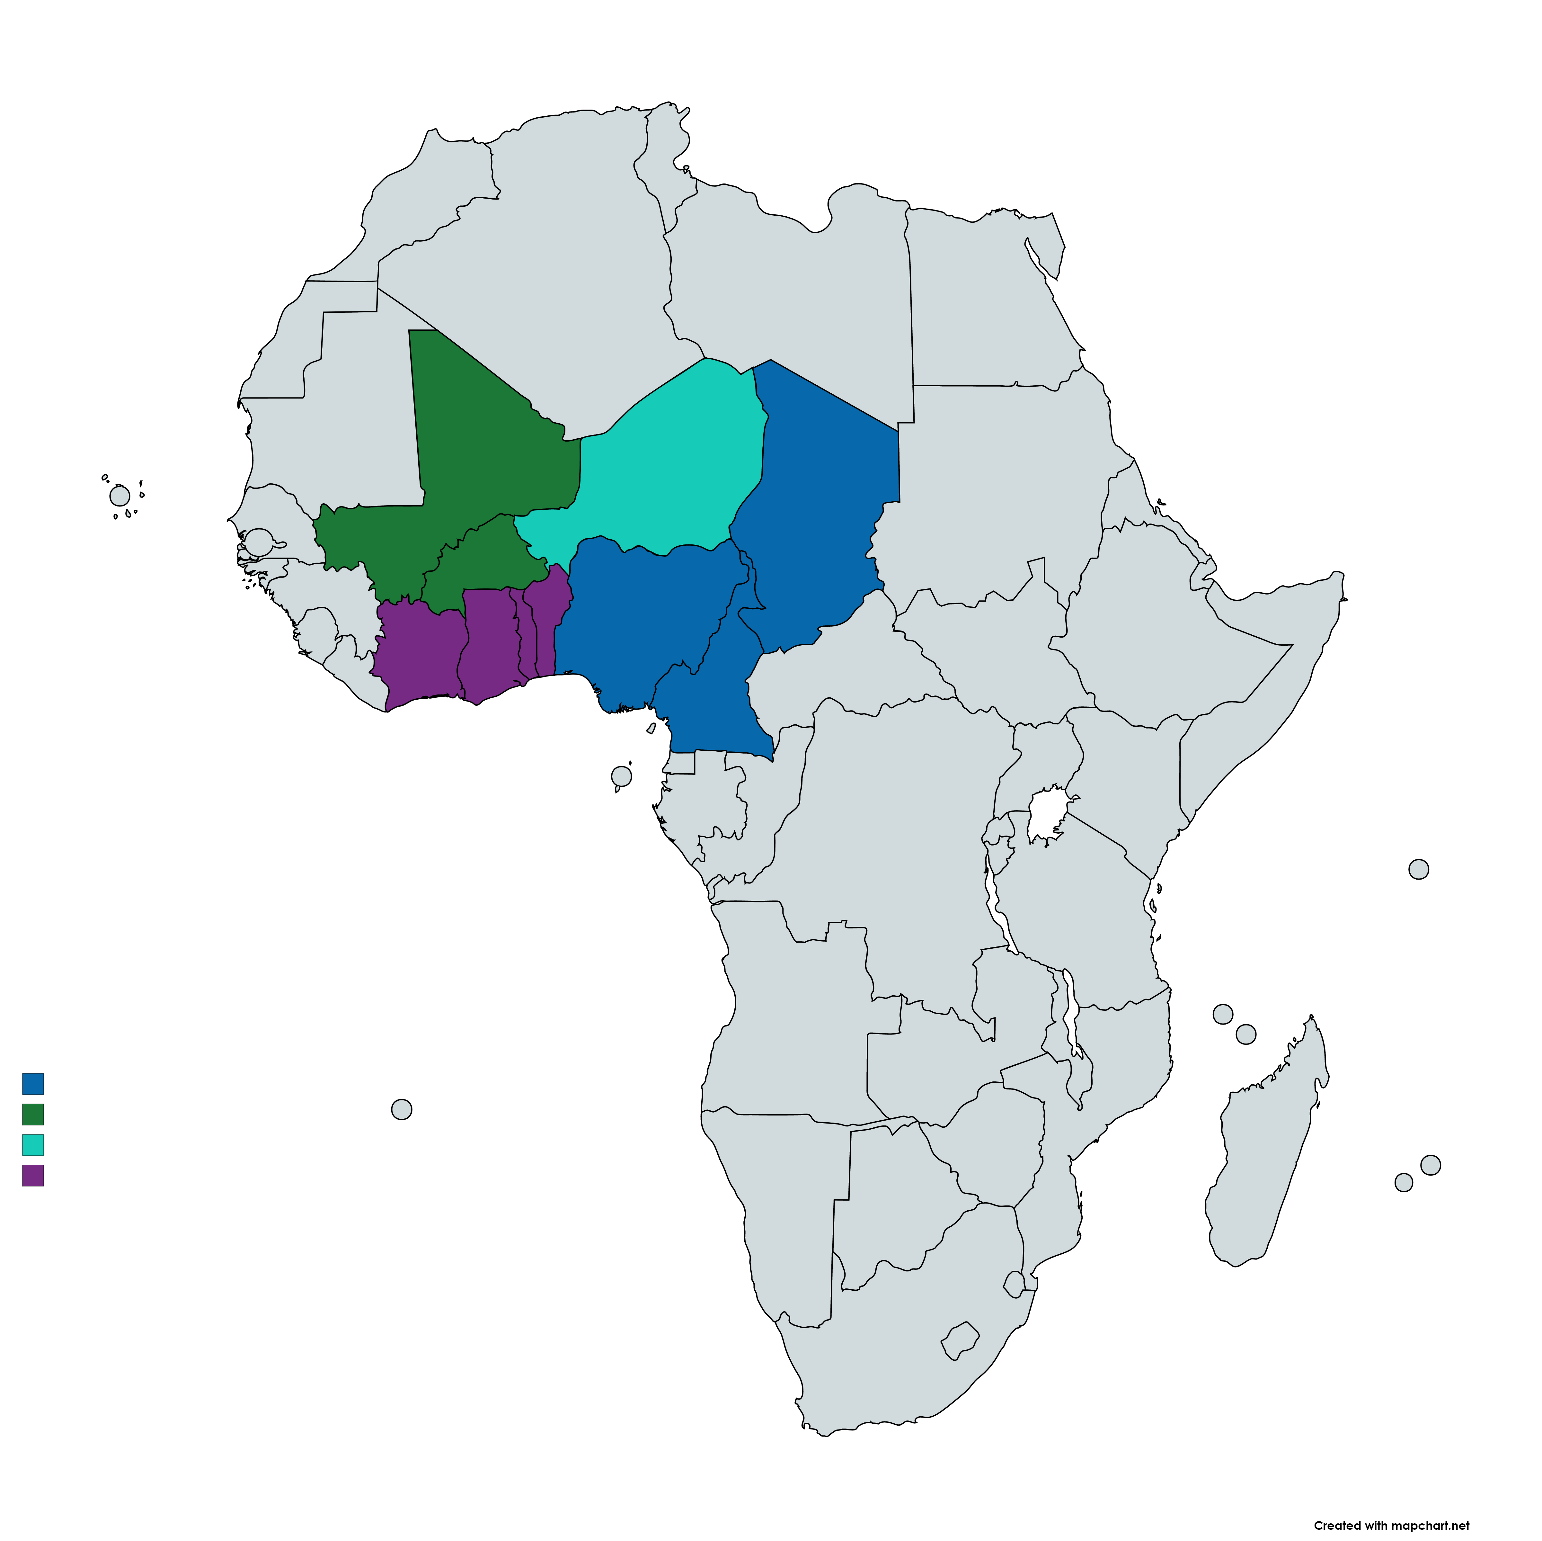
A Regional Approach
Regional Community Local Development and dialogue in Lake Chad, Sahel and Northern Regions of the Gulf of Guinea – Think regionally to act locally
The deteriorating context in those hotspots accelerated over the past years, and regional response is becoming crucial to address the situation. Those operations are catalytic to support strategic dialogue and integrated approaches in fragile zones in lagging areas.
Project design was guided by FCV drivers & security situation analyses and considerations on how to address root causes
Sahel 3 Borders area (Burkina Faso, Niger and Mali)- $352.5 M
Lake Chad (Niger, Chad, Cameroon + Nigeria) $170 M +$190 M
Northern Regions of the Gulf of Guinea (Cote d’Ivoire, Ghana, Togo and Benin) $ 450M
Lack of social cohesion and trust
Limited voice and resilience, especially of vulnerable groups
Ineffective institutions and regional dimension of fragility
to strengthen regional stability and prosperity, the response needs to be….
Regionally Coordinated, and 2) People-centered

Slide 3
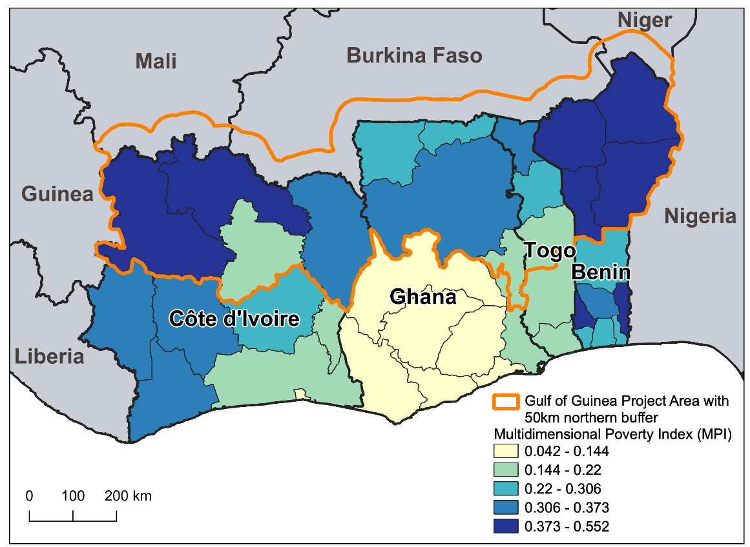
Gulf of Guinea Northern Regions Social Cohesion Project
Context: Northern lagging areas of Gulf of Guinea countries (Cote d’Ivoire, Ghana, Togo, and Benin) are increasingly facing:
FCV Spillover risks from the Sahel
Perception of exclusion originating from insufficient state presence, higher poverty rate, insufficient decentralization, lower access to basic services and markets, and lack of voice and insufficient participation in decision-making processes - exacerbate vulnerabilities
High risk to climate change impacts poses another regional threat (dependent on subsistence agriculture)
COVID shocks/risks could exacerbate such structural drivers of FCV.
Objective:
To improve regional collaboration and the socioeconomic and climate resilience of border-zone communities in the target northern regions of the Gulf of Guinea countries exposed to conflict and climate risks.

Slide 4
Components
Component 1
Investing in Community Resiliency and Inclusion
USD 112.5M, 75%
.
Component 2
Building Foundation and Capacity for Inclusive and Resilient Communities.
Component 3
Regional Coordination Platform and Dialogue.
Sub-Component 1.1 : (USD 84M)
Community investments for strengthening local resilience and inclusion
Component 4
Project Management
Component 5
Contingent Emergency Response Component.
Sub-Component 1.2 : (USD 22.5M)
Strategic economic investments for climate-resilient economic development
Sub-Component 1.3 : (USD 5.6M)
Youth engagement and social cohesion activities

Slide 5
Geographical Focus
Geographic focus:
6 regions: Northern, North East, Oti, Savannah, Upper East, and Upper West
48 districts (approximately 80% of all the districts in the North)
Implementing agency:
Ministry of Local Government, Decentralisation, and Rural Development (MLGRD)
Working also with National Development Planning Commission, Ministry of Youth and Sports; Ministry of Gender, Children and Social Protection etc.

Slide 6
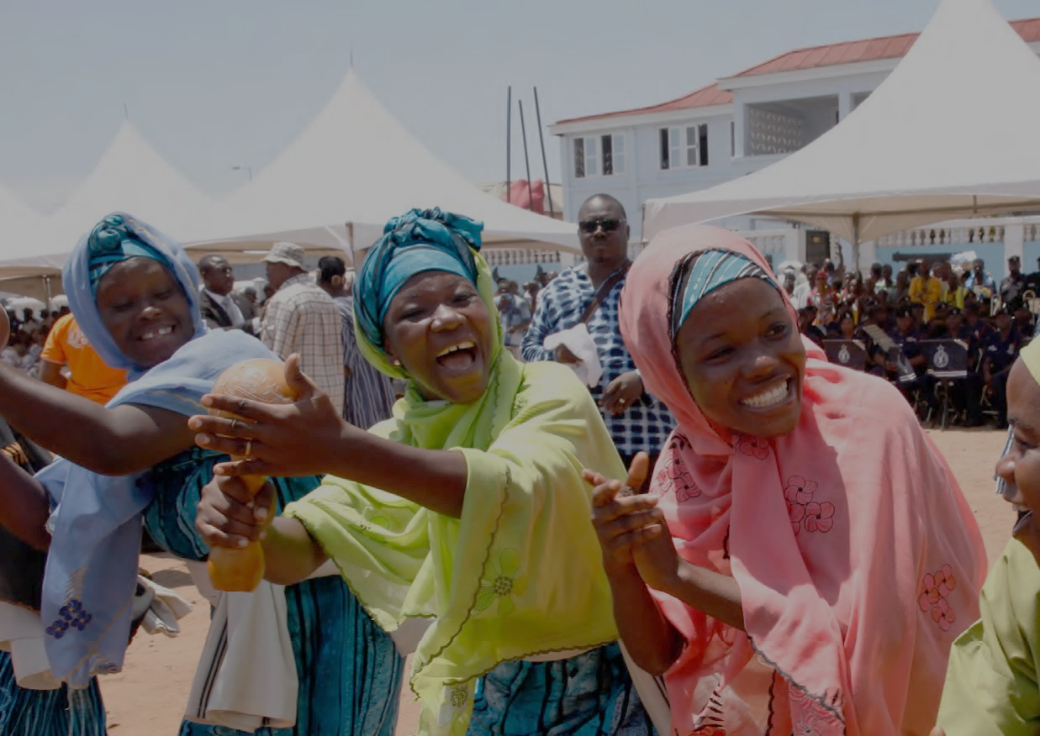
Broader Objectives
Women empowerment
Social inclusion and voice
Social cohesion
Build resilient communities
Providing climate resilient infrastructure
Building Capacities
Digital literacy and inclusion
Building public trust and civic engagement
Partnership for synergy

Slide 7
Progress
YEAR 1
Clusters
217
communities
> 1500
social infrastructure
> 500

Slide 8
A catalyst for Coordinated Approach and
Integrated Development in Northern Ghana
The SOCO Project seeks to partner with key development actors in the north to leverage their knowledge and work together to fill the development gaps
These partnerships are also essential for maximising impact through coordinated efforts, facilitating learning and innovation through data, information, experiences, and best practices sharing; and strengthening social accountability and transparency.
Partners include:
National and local government institutions and structures,
Development Partners
Non-Governmental Organizations, Faith Based and community-based organisations,
Civil Society Organisations and development agencies of governments

Slide 9
A catalyst for Coordinated Approach and
Integrated Development in Northern Ghana
SOCO covers around 80% of districts in Northern Ghana
Foster a comprehensive multi-sectoral and multi-partner response and enhance coordination and monitoring (Avoid silos)
Collaborating with NDA and all the major Development Partners (DPs)
Scoping study – August 2022 to April 2023
Digital Knowledge Platform – April 2023
BBL/webinar Series – from Dec 2022-March 2023
Development Partner workshop in April 2023
Conference on Northern Ghana
Digital data fellows' initiative in July 2023 to promote a data-driven and evidence-based approach
Promoting a Local Economic Development (LED) and Integrated Rural Development approach
Investing in building LED public-private partnership platform at the local government level
Collaborating with relevant WB-financed projects and government flagship initiatives
Piloting intensive LED and integrated rural development approach in a few SOCO districts in the next 2-3 years
Supporting Innovations
Social Cohesion
Climate resilience
Cross-border initiatives
Digital innovations
Youth empowerment
Women’s economic empowerment
Social Risk Management

Slide 10
OBJECTIVES OF THE DEEP DIVE WITH PARTNERS
The Deep Dive Workshop forms part of a broader ongoing dialogue with the various DPs
Specific areas of collaboration with DPs/ agencies falls within the local economic development; social cohesion; and local governance thematic areas
Beyond this initial deep dive workshop, the team will continue engagements with other DPs to explore potential partnerships
A larger DP forum will also be convened - as part of the Conference on Northern Ghana in November 2023, jointly organised by the Ministry, National Development Planning Commission and the Northern Development Authority (NDA)
Aim
To concretise further and firm up how to collaborate to implement specific activities with identified with partners

Slide 11
DIGITAL INNOVATIONS
LOCAL ECONOMIC DEVELOPMENT
GOVERNANCE /SOCIAL COHESION / ACCOUNTABILITY
OBJECTIVES OF THE DEEP DIVE WITH PARTNERS

Slide 12
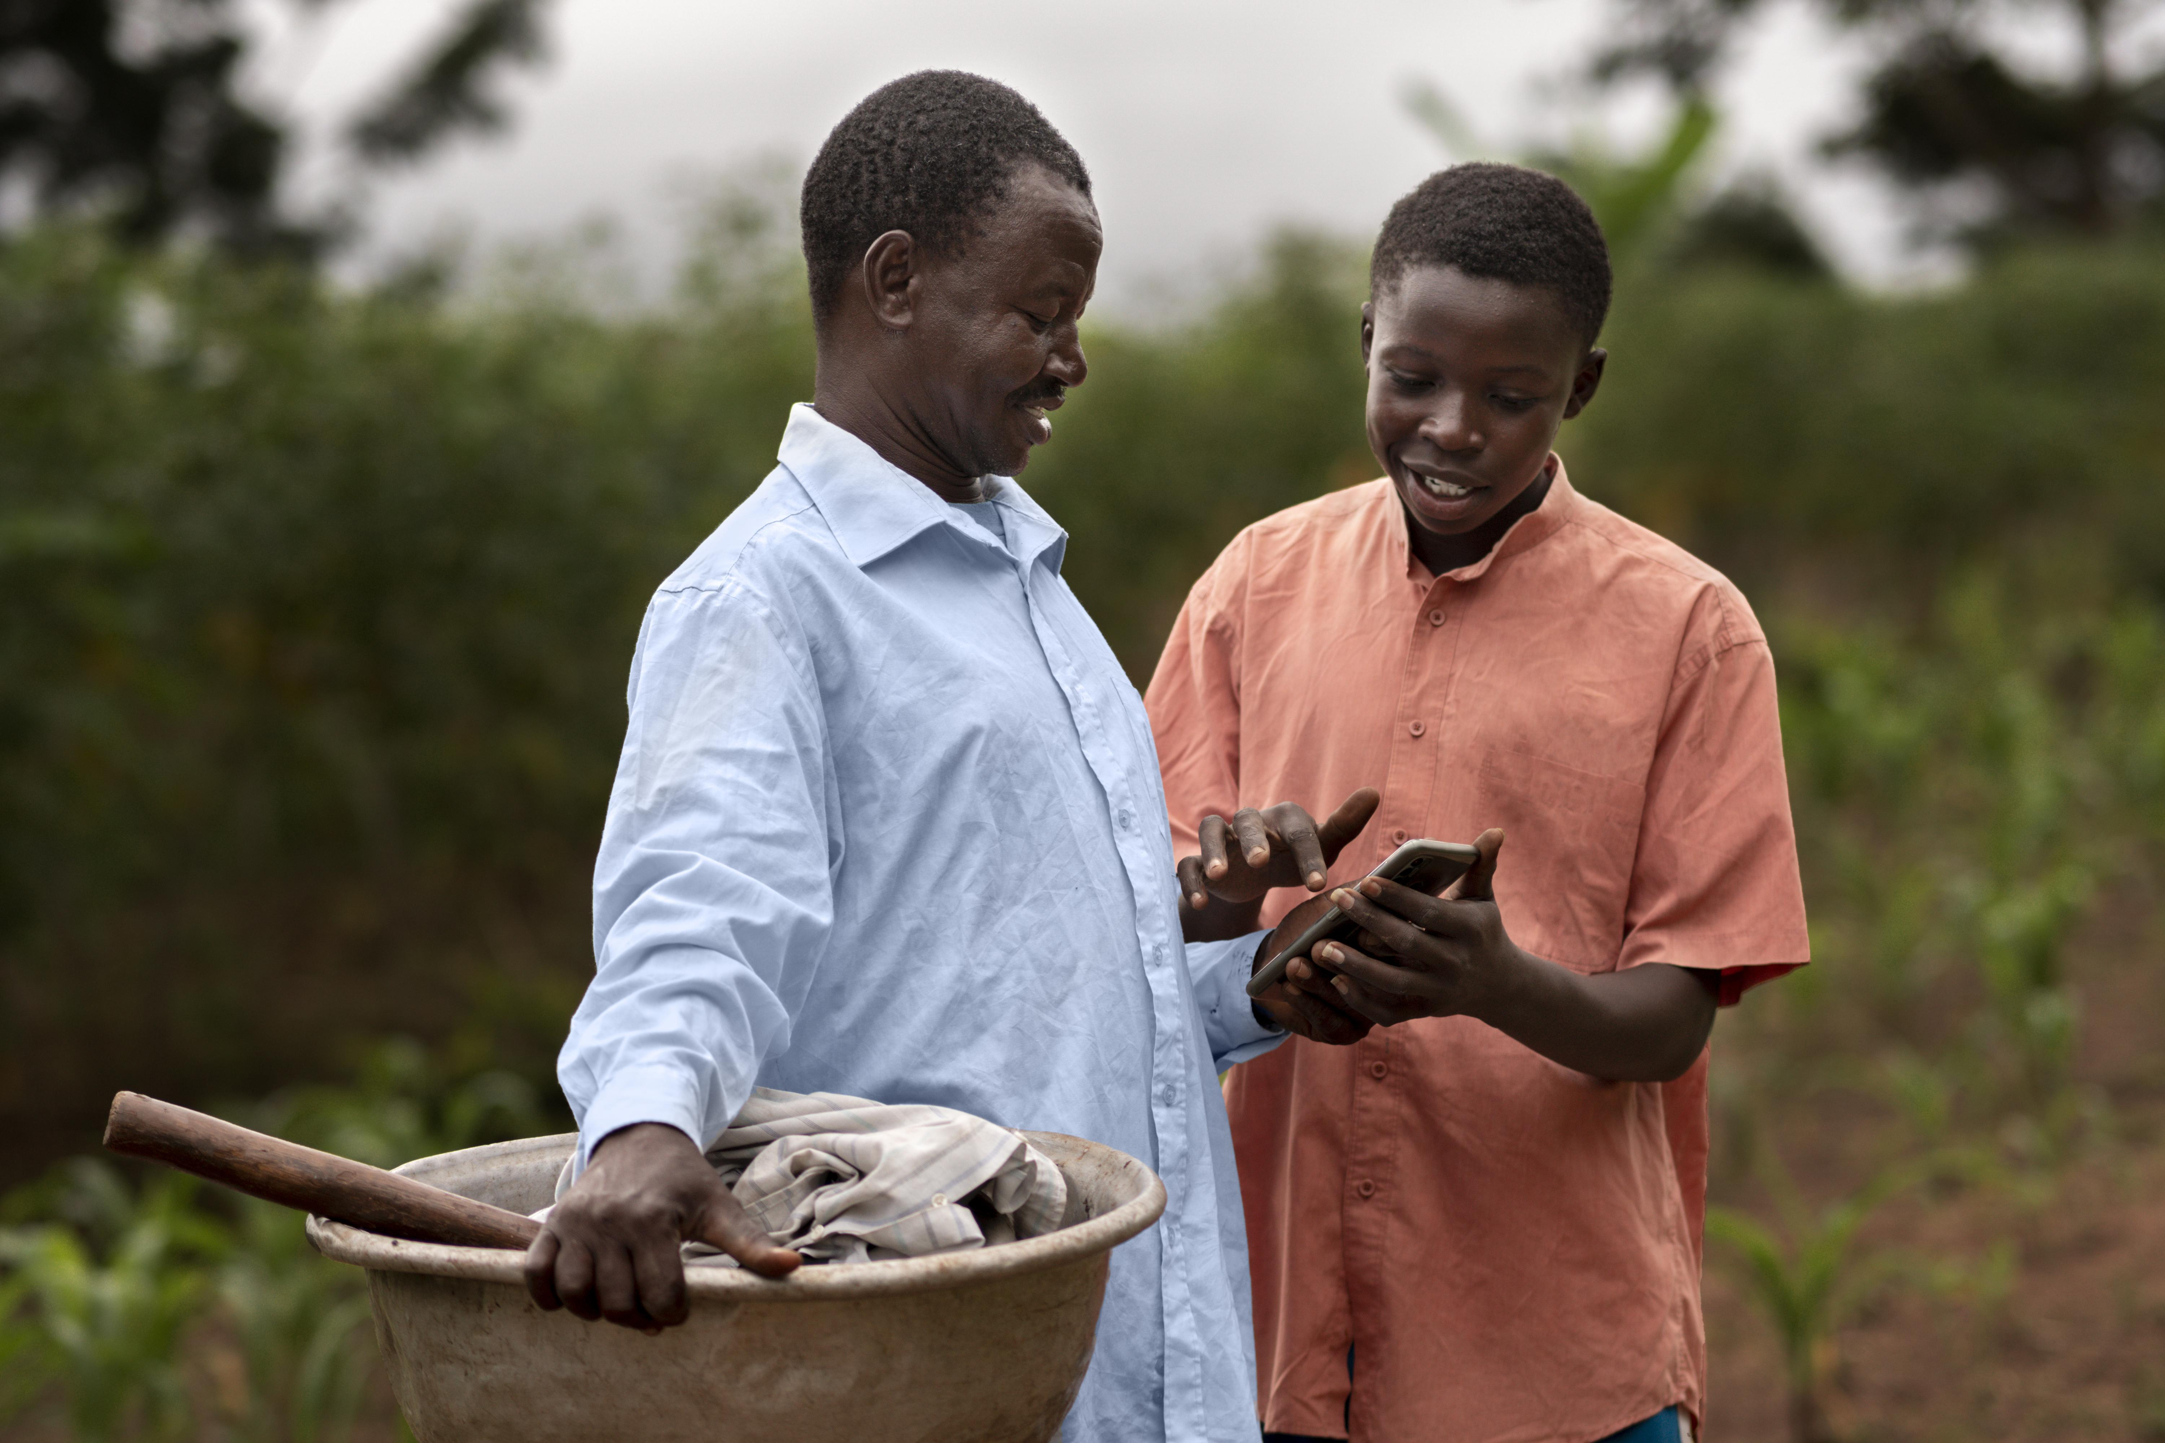
BREAK OUT SECTIONS
Digital innovations
The SOCO Project incorporates digital innovations in all facets of project implementation.

Slide 13
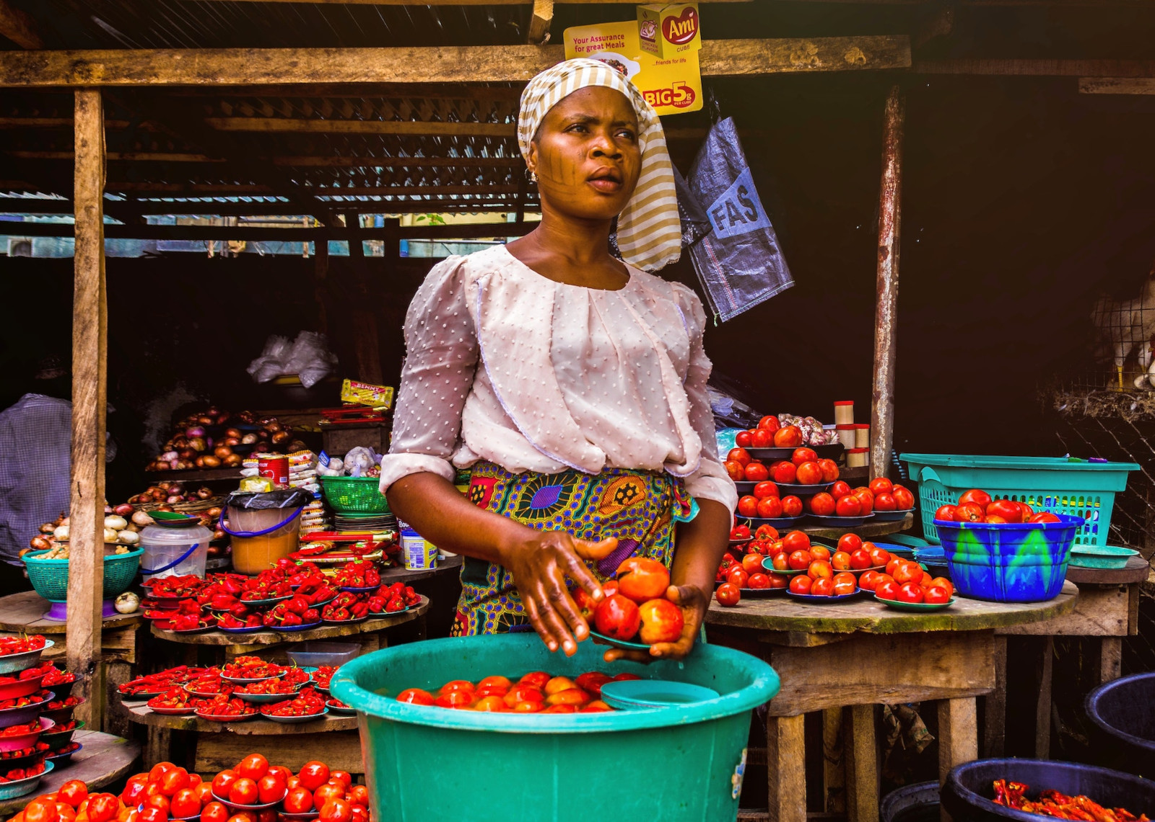
Local Economic Development
A multi-stakeholder, multi-sectoral and multi-dimensional approach that responds to and enhances coordination and collaboration of all economic development activities at the local level.
Piloting the Intensive Approach in 3 districts as a model for large-scale transformative impacts in target districts.
BREAK OUT SECTIONS

Slide 14
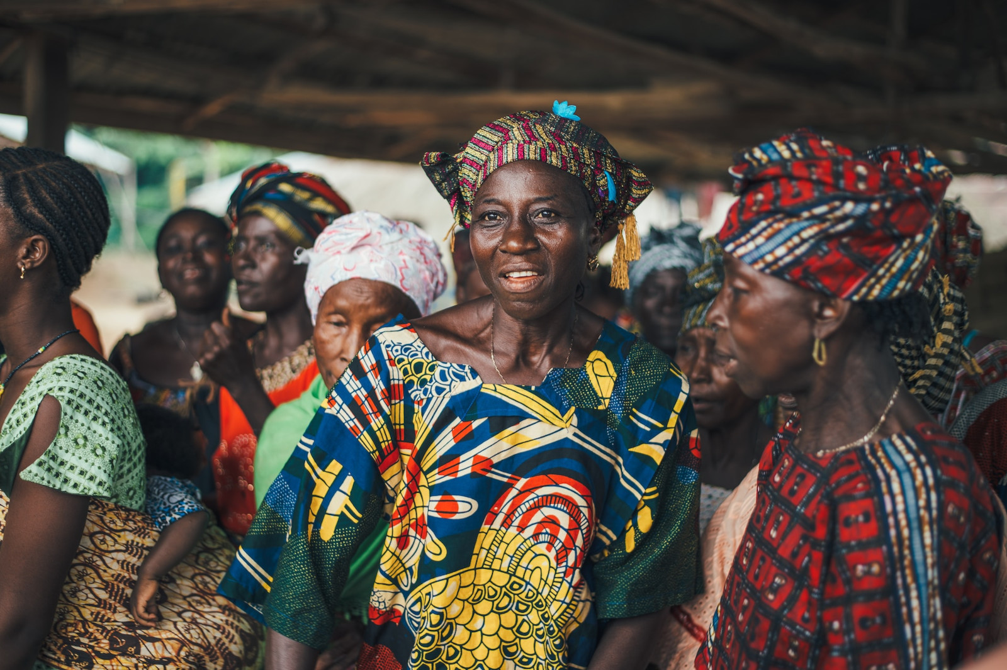
Local Governance/ Social Cohesion and Accountability
Focusing on:
Social cohesion through dialogues
Social Inclusion
Strengthening of institutions
Building capacities
Social Accountability
BREAK OUT SECTIONS

Slide 15
What’s next Today?
Break out Sessions
Plenary
Follow up
PRESENTATION OF PARTNERS’ INITIATIVES
PRESENTATION ON AGREED COLLABORATIONS AND ACTIONS
INITIATE ACTION ON KEY NEXT STEPS
Have a deeper discussion on Partners’ activities and proposed areas of collaboration
Report back to the larger group for further discussions, inputs and streamlining
Share relevant information to initiate modalities for partnerships

Slide 16
THANK YOU

